Slide 1
Health Information National Trends Survey:
Feature Selection
Week 3 - IDS 506

Slide 2
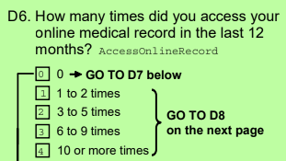
Purpose
Create a model to understand characteristics of patients who use the EMR system
Spending resources to convince those most likely to use EMR system attempts to ensure usage
An increase in the EMR system saves labor costs
Less resources toward call center and customer service personnel
Drives the healthcare system to be more self-sustainable in the long run
Deal with trade-offs between cost and accuracy when building our model (FP vs FN)
Potential features/inputs for the model:
Questions in Health Information National Trends Survey
Target variable
Question D6
Multiclass:
0 : 0 access
1 : 1 to 2 and 3 to 5 times
2 : 6 to 9 and 10 or more times

Slide 3
Selected Questions & Classes
 |  |  | QUESTIONS
A | B | C | D | G | I | O
1 | 1 | 1 | 1 | 1 | 1 | 1
2 | 2 | 2 | 2 | 2 | 2 | 2
3 | 3 | 3 | 3 | 3 | 3 | 3
4 | 4 | 4 | 4 | 4 | 4 | 4
5 | 5 | 5 | 5 | 5 | 5 | 5
6 | 6 | 6 | 6 |  | 6 | 6
7 | 7 | 7 | 7 |  | 7 | 7
8 | 8 |  | 8 |  | 8 | 8
 | 9 |  | 9 |  |  | 9
 | 10 |  | 10 |  |  | 10
 | 11 |  | 11 |  |  | 11
 | 12 |  |  |  |  | 12
 |  |  |  |  |  | 13
 |  |  |  |  |  | 14
 | Very Sure |  |  |  |  | 15
 | Somewhat Sure |  |  |  |  | 16
 | Data Leakage |  |  |  |  | 17
 |  |  |  |  |  | 18
 |  |  |  |  |  | 19
Selected Class | Questions
1. Demographics | O1, O2, O3, O4, O5, O6, O7, O9, O10, O11, O12,O14,O16,O17,O19
2. Health Related | C2, C3, C5, C6, D1, G1, G3
3. Lifestyle Related | I1, I2, I3, I4, I7
4. Personal Info. Security/Privacy | D2, D3
5. Tech/EMR Related | B1, B7, B8, B9, B10, B11, D4, D5, D10
6. Cancer Related | A7, A8

Slide 4
Evaluation Metric
Target variable
Three classes
0 : 0 access
1 : 1 to 2 and 3 to 5 times accessed medical record online
2 : 6 to 9 and 10 or more times accessed medical record online
F1 score - F1 Score is the weighted average of Precision and Recall.
F1 Score = 2*(Recall * Precision) / (Recall + Precision)
True Positive (TP): Labeled as class 1 or 2 and is 1 or 2
False Positive (TP): Labeled as class 1 or 2 but is actually class 0
False Negative (FN): Labeled as class 0 but is actually class 1 or 2
Limiting False Negatives and False Positives is important for our goal of identifying patients who access their medical records online
Notes:
Step forward feature selection starts with the evaluation of each individual feature, and selects that which results in the best performing selected algorithm model. What's the "best?" That depends entirely on the defined evaluation criteria (AUC, prediction accuracy, RMSE, etc.). Next, all possible combinations of the that selected feature and a subsequent feature are evaluated, and a second feature is selected, and so on, until the required predefined number of features is selected.

Slide 5
Feature Selection Process
Select questions or features that help describe the nature of people who use the EMR system
Group identified features we believe are related or potentially related to using the EMR system
Use Forward Selection method to identify the combination of features that produce the highest Recall
Features should be identifiable for future patients
Complete # of Questions in Survey: 70
Choose a classification algorithm
Features should provide a profile for our target classes
Questions Our group Chose: 43
Use F-1 to take into consideration both precision and recall
Choose 5 to 10 best features that produce highest F-1
Notes:
Step forward feature selection starts with the evaluation of each individual feature, and selects that which results in the best performing selected algorithm model. What's the "best?" That depends entirely on the defined evaluation criteria (AUC, prediction accuracy, RMSE, etc.). Next, all possible combinations of the that selected feature and a subsequent feature are evaluated, and a second feature is selected, and so on, until the required predefined number of features is selected.

Slide 6
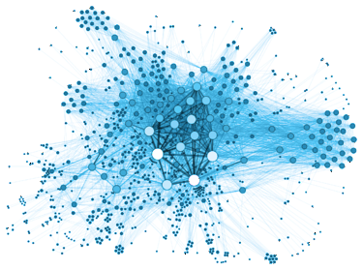
Next Steps: Data Transformation & Model
Which customers (with given characteristics) are likely to use the patient portal app
How to market the idea of app usage to them/what incentives
Data Transformations
Predict
Consider relevant Questions( 43)
Forward Selection
Multiclass Classification
With SVM
Scale the features
Normalize the features
Remove the outliers, if any
Define Train & Test
Define the SVM kernel
Find the Characteristics of people with high app usage
Feature Selection
Classification

